Slide 1


Slide 2


POLICY FORUM
Rethinking Irish Economic Development
WIFI ACCESS
UCC Guests
username: policyforum-nov-17
password: Xqqxkj6q
FOLLOW THE FORUM
#PolicyForum
@CUBSucc
www.cubsucc.com/re-thinking-irish-economic-development

Slide 3
How sustainable are favourable tax policies for future Irish economic development?
Seamus Coffey

Slide 4
Tax and FDI: Sins of Commission
Export Profits Tax Relief (1956)
  0% effective tax on profits from export sales
Manufacturing Relief (1980)
  10% tax rate on profits from manufacturing
Headline Rate (2003)
  12.5% tax on all trading profits

Slide 5
Tax and FDI: Sins of Omission
Residence Rules
  Adopted from the British system in the 1920s.
  Based on test of management and control.
  Over time countries moved to test of incorporation
  So too did Ireland in 1999 except….
  …. for certain Irish-registered subsidiaries of foreign-owned companies.
Transfer Pricing
  Always an implicit part of Irish tax law.
  OECD standards formally adopted into Irish law in 2010.
  Only for trading activities but grandfathered to 2020.
  Does not cover non-trading or capital transactions.

Slide 6
Success?
  Each year in Ireland, US companies:
  Spend €6 billion on personnel costs on their 100,000 direct employees,
  Undertake around €3 billion of capital expenditure on tangible goods,
  Buy €4 billion of goods and services from Irish suppliers,
  Make around €3 billion of Corporation Tax payments to the Exchequer.
  €16 BILLION A YEAR, EVERY YEAR
  There’s a reason tax and FDI is front-page news.

Slide 7
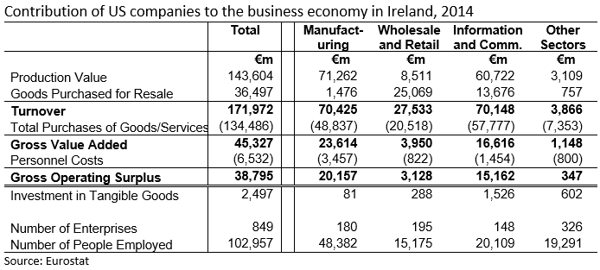
The Sectors of our Success

Slide 8
External Threats?
  OECD
    Base Erosion Profit Shifting project (BEPS)
  EU
    Common Consolidated Corporate Tax Base (CCCTB)
    State Aid Investigations
  UK
    Lower rate
    Exclusion from from EU state aid rules
  US
    Destination Based Cash Flow Tax (DBCFT)
    Lower rate
    Switch to territorial system

Slide 9
In a “sweet spot”
  Ireland is currently in a sweet spot for investment, employment and Corporation Tax from US MNCs:
  The companies want to invest abroad.
  Historic interaction with US tax rules (by design or by default).
  Sectors undertaking large capital investment such as in bio-pharma or data centres.
  Companies have substance and employees here.
  BEPS project designed to align profit with substance.
  Country-by-country reporting.
  US companies are onshoring some of their internally-generated intangible assets.

Slide 10
How much success?
Relative importance
The contribution of US companies to the business economies of the EU.
Relative success
The distribution of US companies’ contribution to the business economies of the EU.

Slide 11
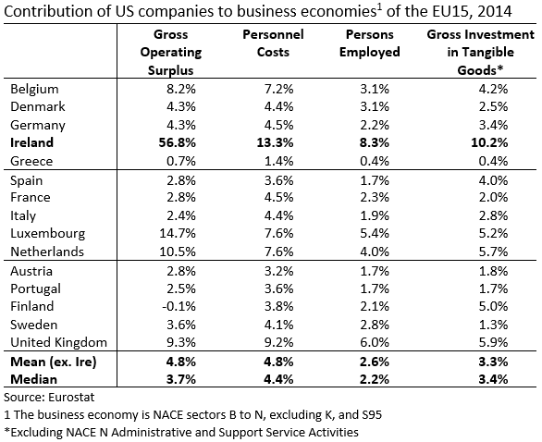

Slide 12
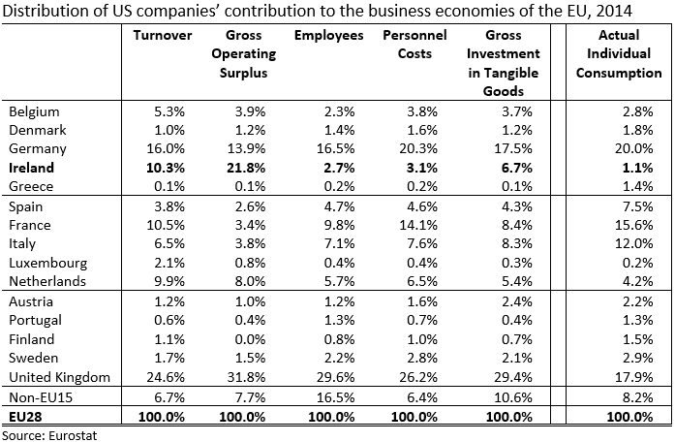

Slide 13
An unintended success?

Slide 14

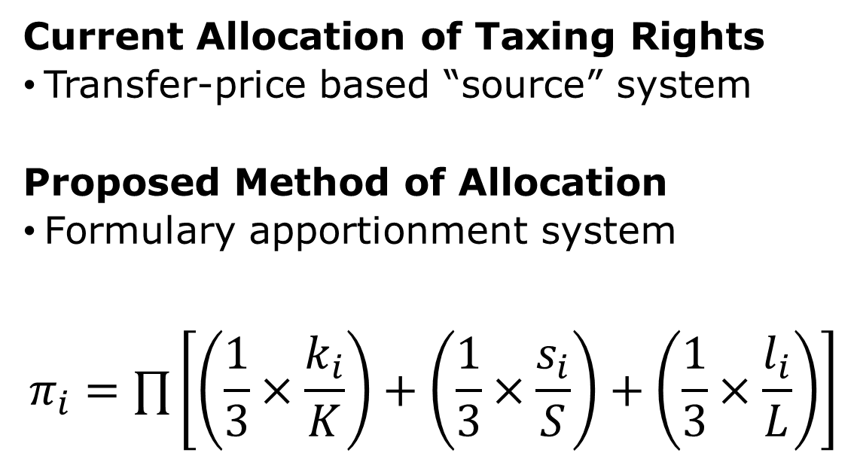
The green-eyed monster
Current Allocation of Taxing Rights
Transfer-price based “source” system
Proposed Method of Allocation
Formulary apportionment system
$$π_{i}=∏\left[\left(\frac{1}{3}×\frac{k_{i}}{K}\right)+\left(\frac{1}{3}×\frac{s_{i}}{S}\right)+\left(\frac{1}{3}×\frac{l_{i}}{L}\right)\right]$$

Slide 15
CCCTB and Pharmaceutical Manufacturing
Almost 1/4 of the GOS in the EU from the manufacture of pharmaceuticals is located in Ireland via transfer prices.
The source principle grants Ireland the taxing right to this profit.
Ireland collects €1 billion per annum in CT from this.
However, under a CCCTB scenario note Ireland has:
  8% of the capital investment
  3% of the employees
  4% of the employee costs
  1% of sales
  This would give Ireland c.5% of the tax base
  – a loss of four-fifths.

Slide 16

An unintended failure?
The profits linked to the onshoring of intangibles will add c.€40 billion of GDP and GNP in 2018.
The gross profits are offset by capital allowances (depreciation) before Taxable Income is determined.
In 2015, a €26 billion increase in intangible related profits was offset by a €26 billion increase in capital allowances for the acquisition of intangibles.
Outcome
  Additional Corporation Tax: nil
  Extra EU contribution: c.€200 million
80% cap introduced in Budget 2018 will raise €150 million – but only for new claims.

Slide 17
Conclusion
Ireland’s FDI strategy is risky but this risk reflects how successful it is.
Ireland has a class of “rent seekers” who are empire building with the money of US shareholders.
The outlook for the medium term is positive.
  Employment (numbers and pay levels)
  Investment (tangible and intangible)
  Tax Revenues (Corporation Tax and others)
Domestic tax system needs incremental improvement (road map).
External threats are probably not as grave once impact by likelihood assessment is done.

Slide 18
POLICY FORUM
Rethinking Irish Economic Development
WIFI ACCESS
UCC Guests
username: policyforum-nov-17
password: Xqqxkj6q
FOLLOW THE FORUM
#PolicyForum
@CUBSucc
www.cubsucc.com/re-thinking-irish-economic-development

